Slide 1
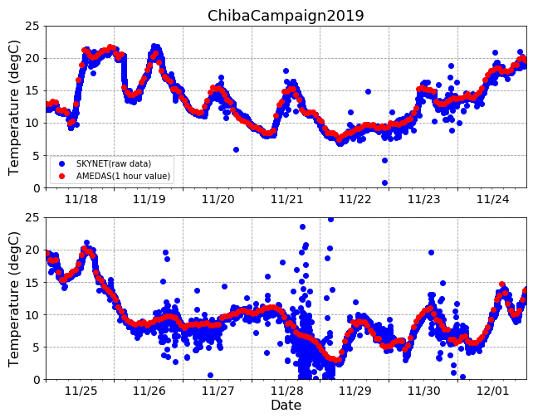
Temperature

Slide 2
Summary
The temperature observed by SKYNET varies greatly when it rains.
→I have no idea why this happens.
About weather with reference to JMA data
Sunny
Cloudy
Rainy
Fog
Why are they scattered in sunny?
Maybe it was raining in Chiba-u.

